Slide 1



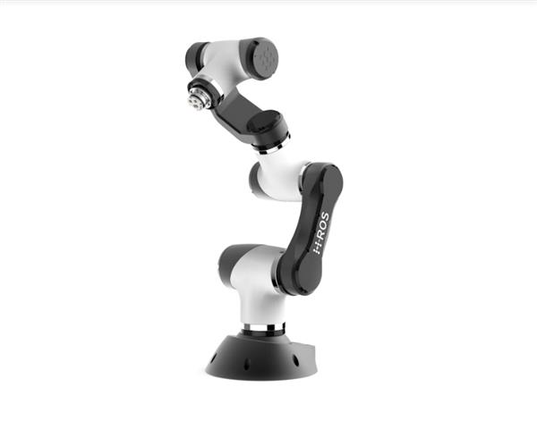

ROS a meta-operating system….

Slide 2
Presentation Outline
Robotics and Its diverse nature.
What is ROS? How it works?
What ROS is not?
ROS Software Types
ROS Concepts
ROS Distros
ROS Code Hierarchy
ROS File System
ROS Computational Graph Model
ROS Command-Line Tools
ROS Visualisation Tools

Slide 3
Robotics and Its diverse nature
A ‘Robot’ an autonomous or semi-autonomous machine guided by the computer to perform a specific task.
Computer Science
Electronics
Mechanical
Robotics

Slide 4
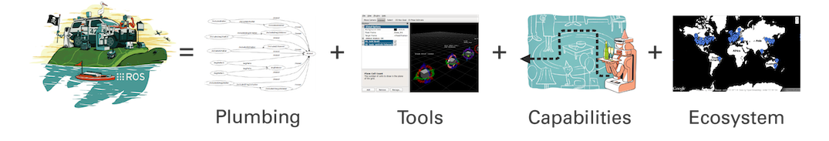
What is ROS?
ROS is a multi-robot platform or a “Federated” open source robotics stack mainly used as set of tools and packages for software development in robotics domain.

Slide 5
What ROS is not ?
ROS is not a programming language.
(c++, Java, Python)
ROS is not a library.
But it has client libraries, a central server, a set of command line and graphical tools
ROS is not an IDE.
it can be used with most popular IDEs. (Eclipse, CLion, PyCharm, Qt creator etc.)

Slide 6
ROS Software Types
Language-and platform-independent tools used for building and distributing ROS-based software
ROS client library implementations such as roscpp, rospy, and roslisp.
Packages containing application-related code which uses one or more ROS client libraries.

Slide 7
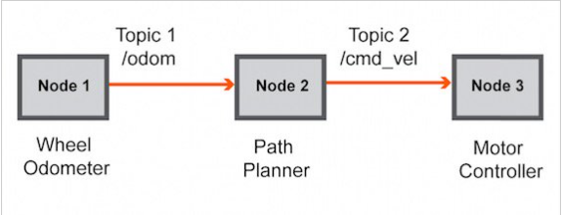
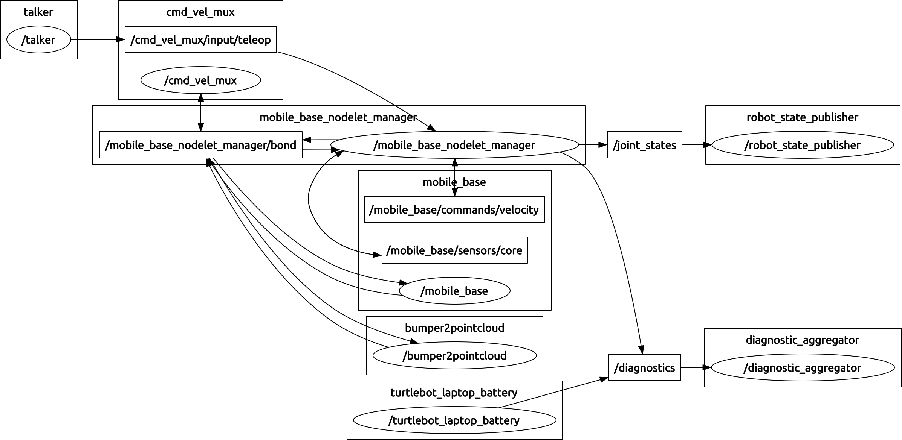
The Working

Slide 8
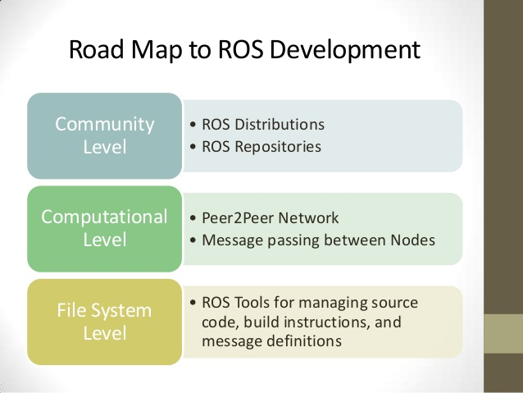
ROS Concepts

Slide 9
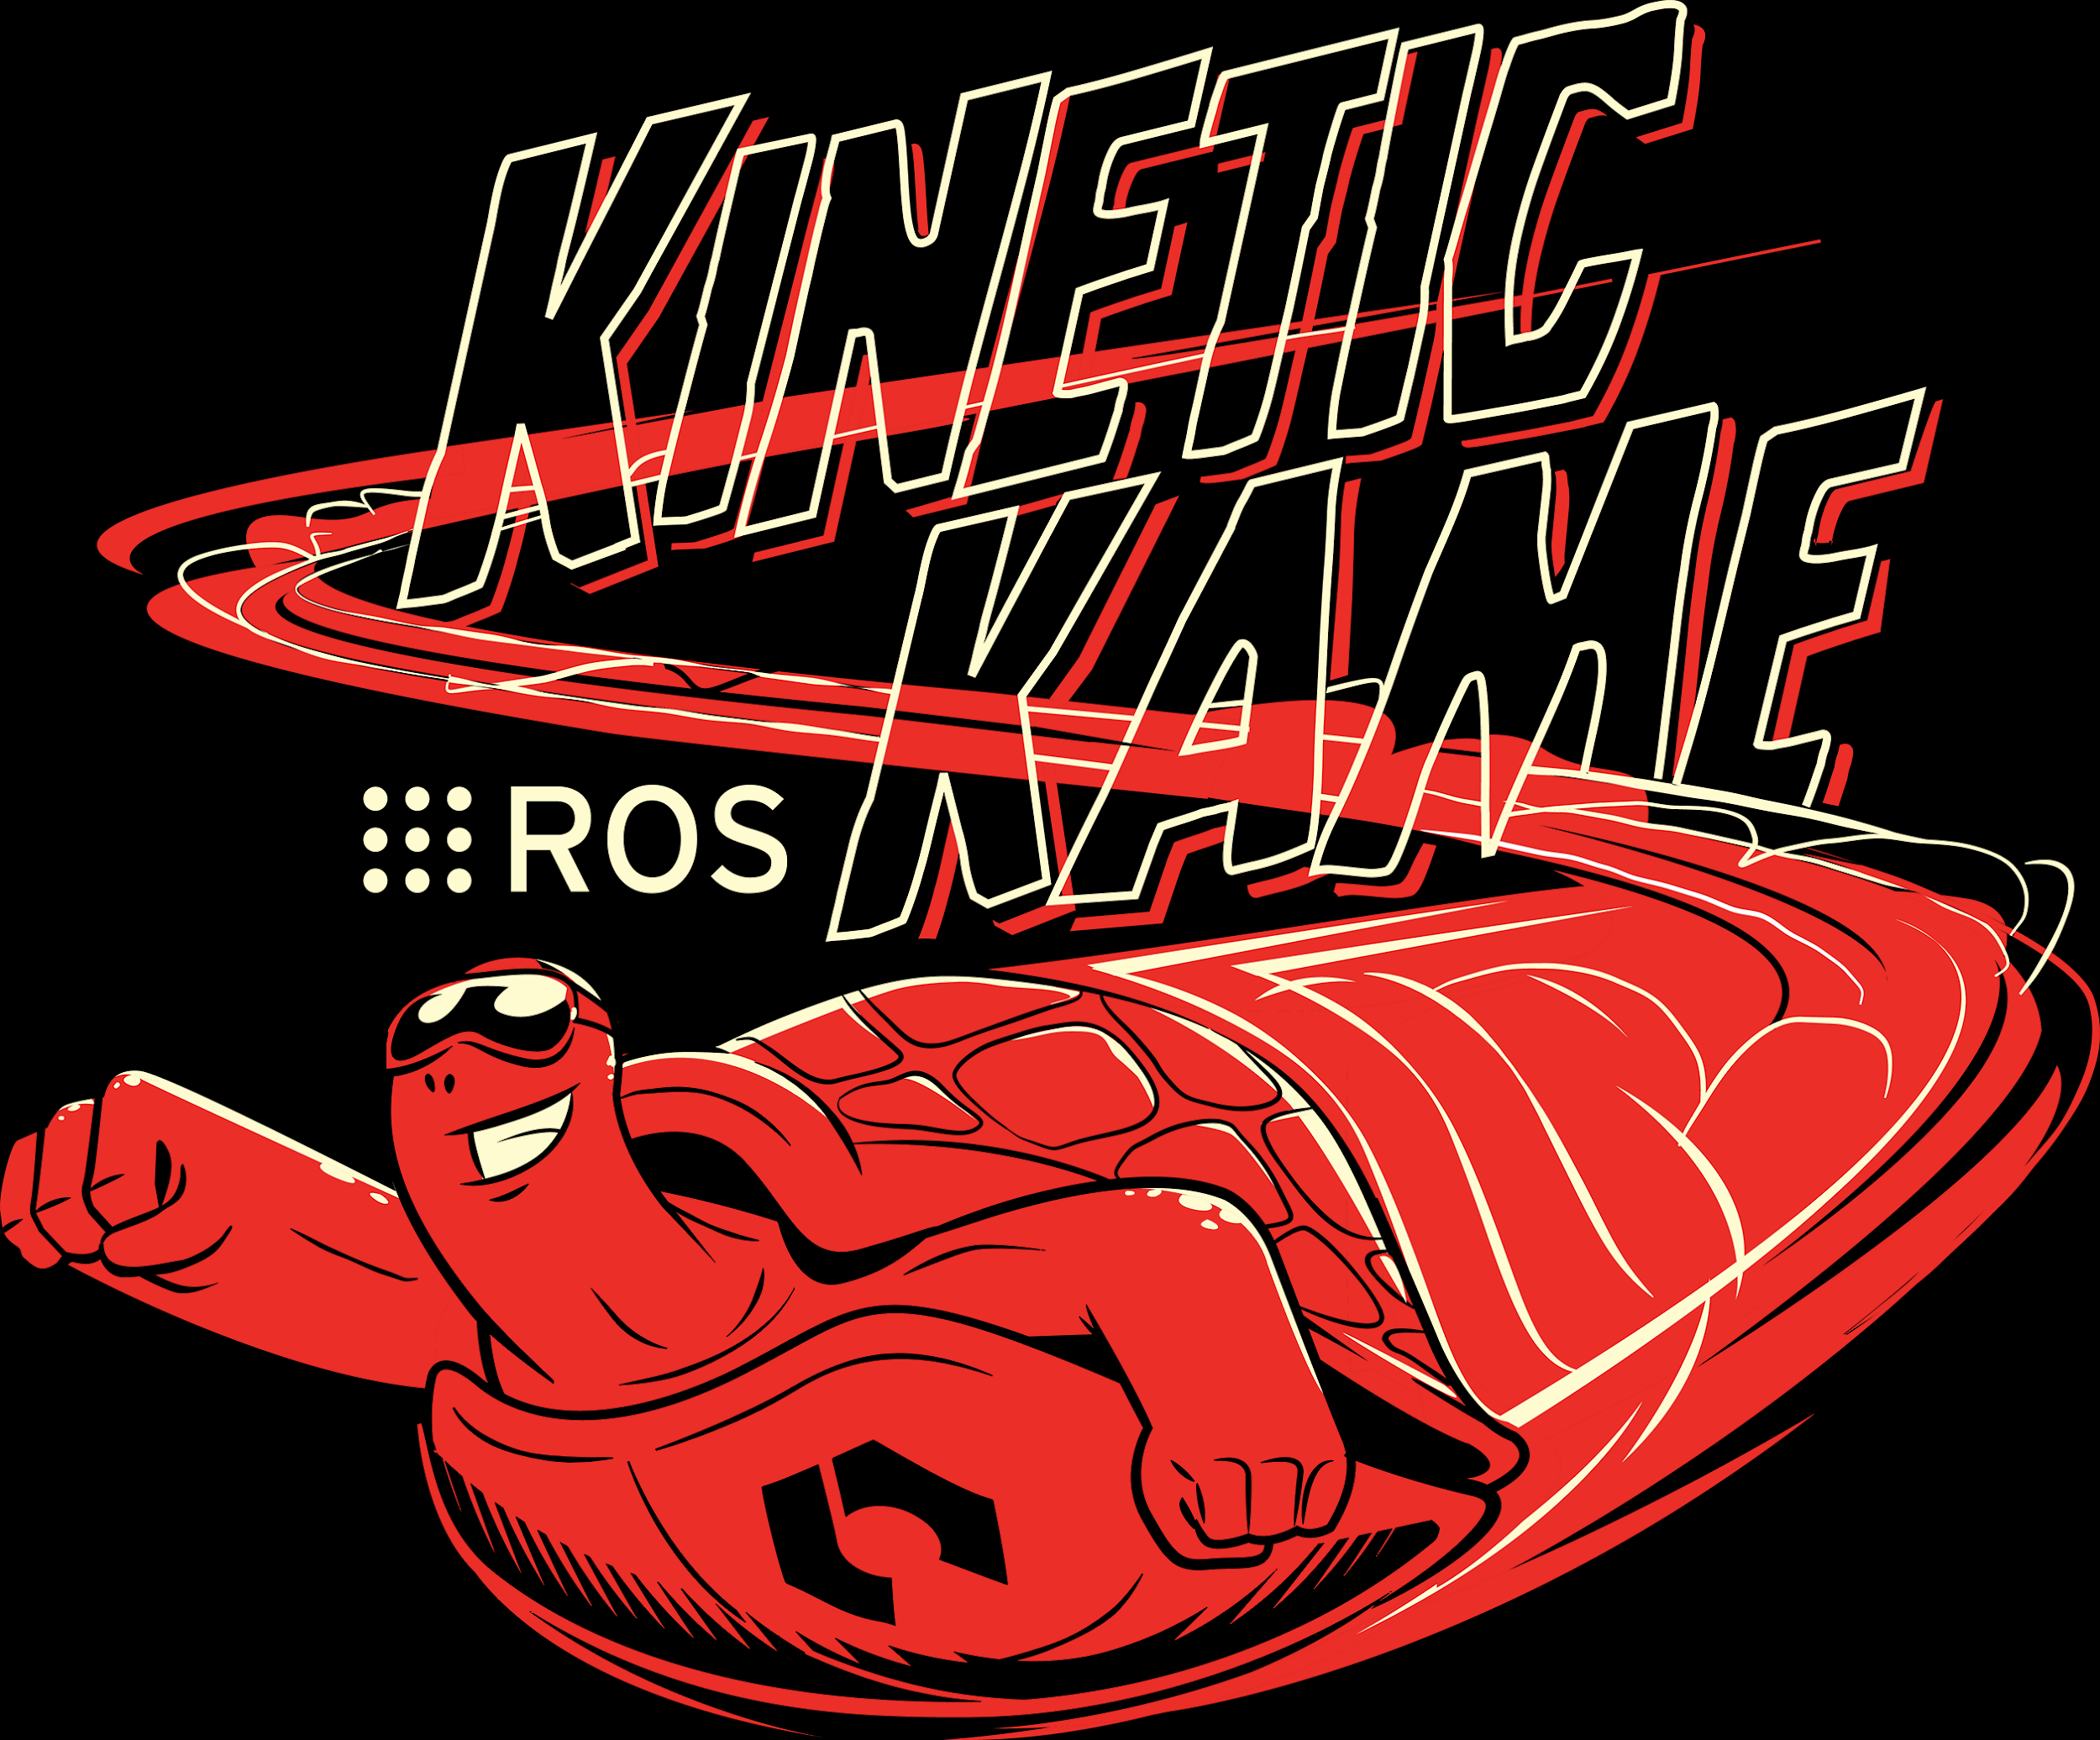
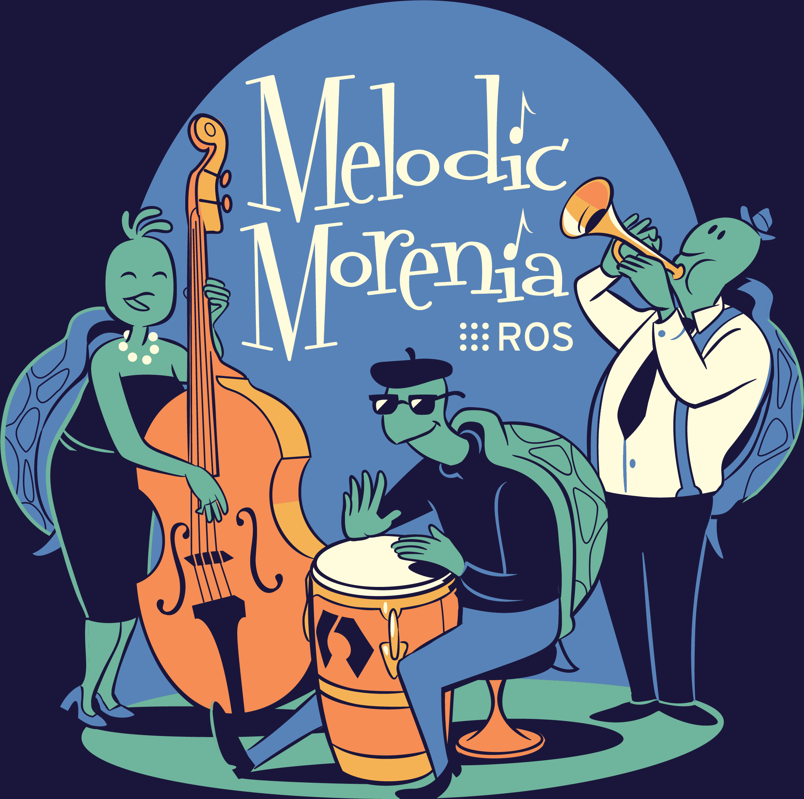
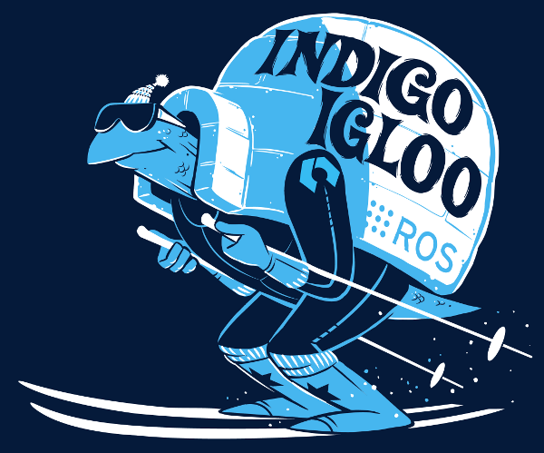
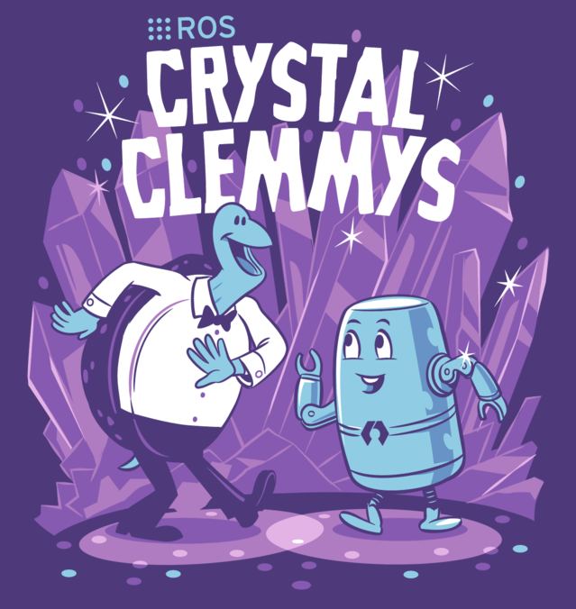

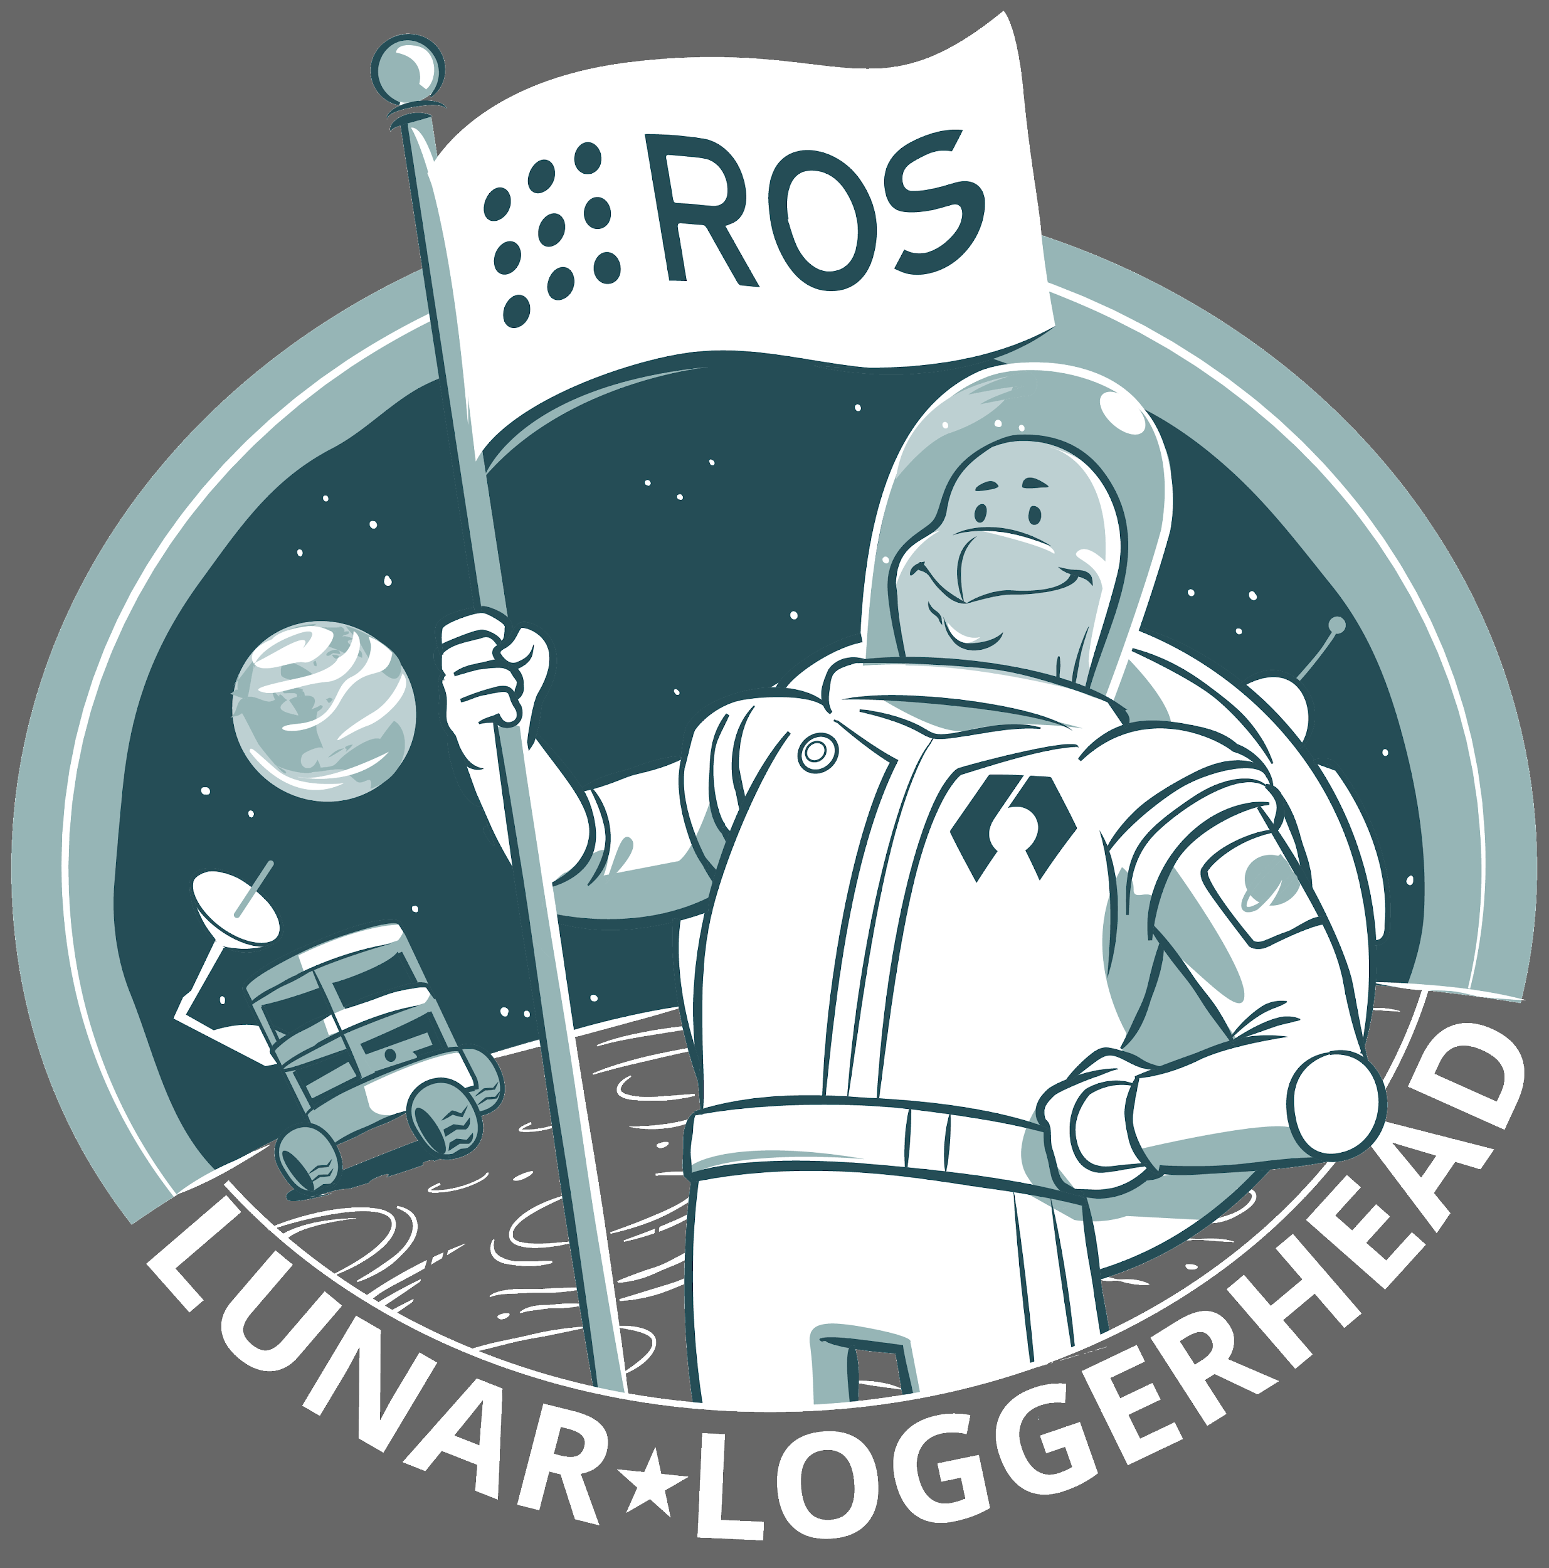
ROS Distros
Notes:
‘distro’ is a term used to describe a specific distribution of Linux that is built from the common Linux operating system and includes additional applications

Slide 10
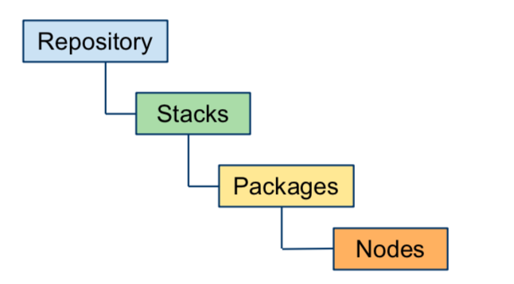
ROS Code Hierarchy
Repository- It contains all the codes from a particular development groups.
Stack - Group of all the codes on a particular subject.
Packages - Separate modules that provides different services.
Nodes - Executable files that exist in each model.

Slide 11
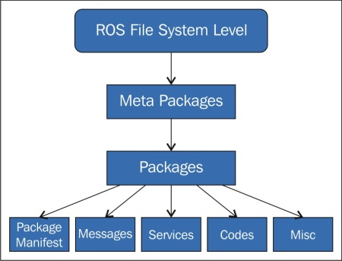
ROS File System (Hierarchy & Architecture)

Slide 12
Meta package - Cluster of all the packages for special purpose maintained by the version control system such as Git, Mercurial etc.
Packages - These are basic units for ROS software which contains nodes, libraries, configuration files stored in organised manner.
Any directory within your ROS package path that contains a manifest.xml file is considered to be a package
Package manifest - Manifest file is much like a README file, stating who wrote your package and what license it is under. The license is important as packages are means by which ROS code is distributed. The most common manifest files also include <depend> and <export> tags, which help manage the installation and use of a package.
It is stored in .xml format
Rospack is the main command line tool for retrieving information about a package.
Messages - ROS messages is the type of information transmitted from one process to another.
The extension for message file is .msg.
The rosmsg command-line tool displays information about ROS Message types.

Slide 13
How to create and build Catkin Workspace
$ mkdir -p ~/catkin_ws/src
$ cd ~/catkin_ws/
$ Catkin_make
$ source devel/setup.bash
Mkdir command in linux allows user to create workspace
Cd is change directory command
Catkin make is used for building the workspace
Source is used to add the file to the shell script.

Slide 14
How to create a ROS package
# creating a catkin workspace
$ cd ~/catkin_ws/src
# creating the package
$ catkin_create_pkg beginner_tutorials std_msgs rospy roscpp
# building and sourcing
$ cd ~/catkin_ws
$ catkin_make
$ . ~/catkin_ws/devel/setup.bash

Slide 15
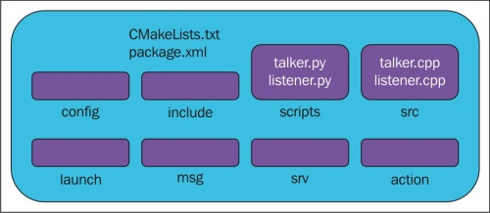
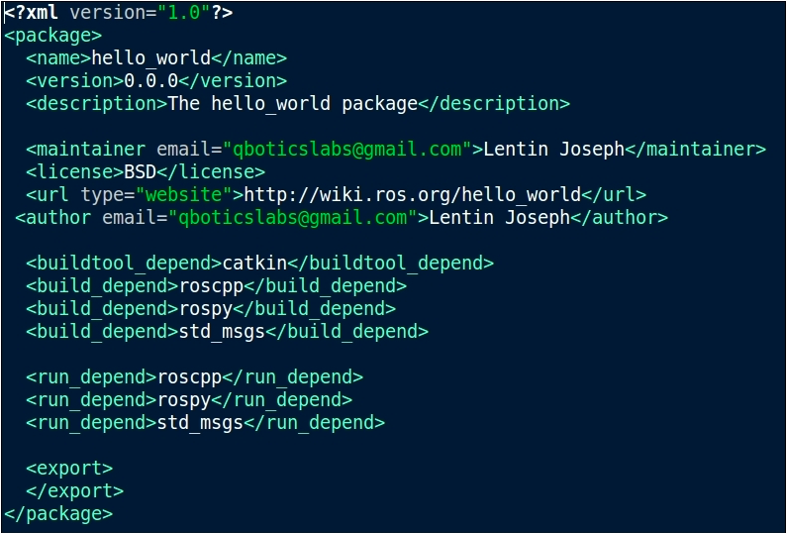
Package.xml File structure

Slide 16
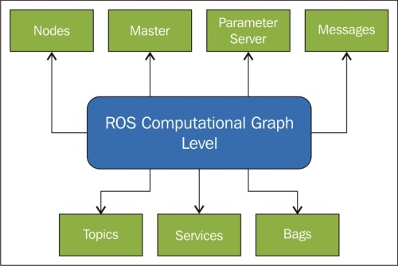
ROS Computational Graph Model

Slide 17
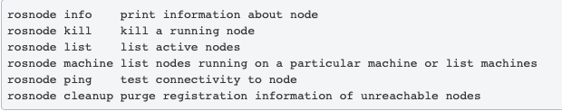
Node - A node really isn't much more than an executable file within a ROS package. ROS nodes use a ROS client library to communicate with other nodes. Nodes can publish or subscribe to a Topic. Nodes can also provide or use a Service. Nodes are provided by the Rosnode package.
Master - A master is incharge of providing services to the nodes. Basically, it provides the nodes with the location and type of other nodes. It tracks publishers and subscribers to topics as well as services. The role of the Master is to enable individual ROS nodes to locate one another. Once these nodes have located each other they communicate with each other peer-to-peer.
The master is provided by the Rosmaster package.

Slide 18
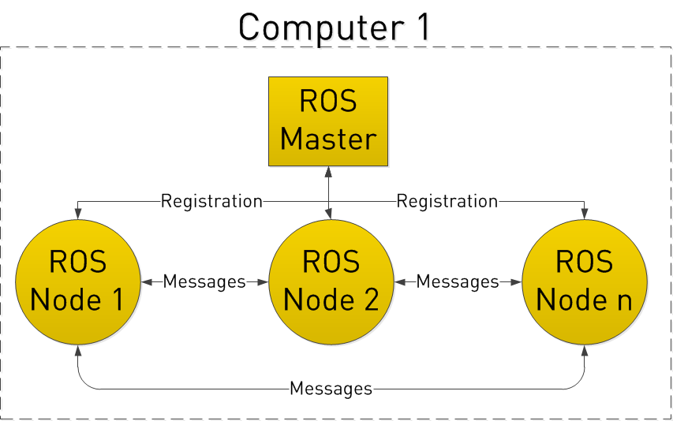
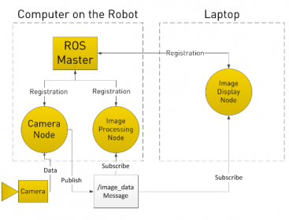
Nodes and Master Communication

Slide 19
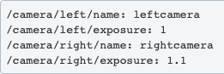
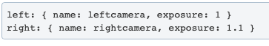
ROS Master
A parameter server is a shared, multivariate dictionary that is accessible via network APIs. Nodes use this server to store and retrieve parameters at runtime.
The Parameter Server is implemented using XMLRPC and runs inside of the ROS Master.
The Parameter Server uses XMLRPC data types for parameter values, which include:
32-bit integers
booleans
strings
doubles
iso8601 dates
lists
base64-encoded binary data
Notes:
RPC

Slide 20
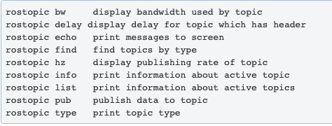
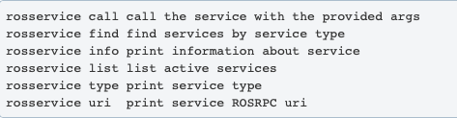
Topics - These are buses which facilitate message delivery from one node to another.
Rostopic is the command line tool to display information about ROS topics.
Services - The ROS services are a type request/response communication between ROS nodes. One node will send a request and wait until it gets a response from the other. The request/response communication is also using the ROS message description. Rosservice is the package which provides the ROS services.
Services are defined using .srv files, which are compiled into source code by a ROS client library.
Notes:
A node uses topic to publish its message which is subscribed by the other node. - ‘The YOUTUBE Analogy’

Slide 21
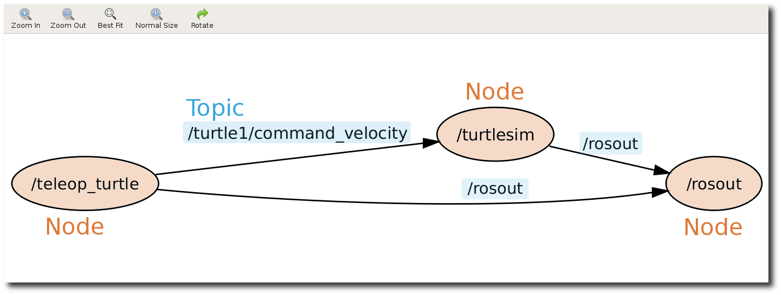
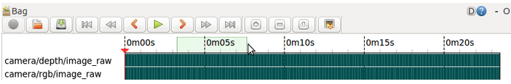
Bags - subscribe to one or more ROS topics, and store the serialized message data in a file as it is received.
bag file toolchain to record datasets, then visualize, label them, and store them for future use.

Slide 22
Command Line Tools
Rosbag - is a command-line tool for performing various operations on ROS bag files, including playing, recording, and validating.
Roscd - It allows you to cd directly to a package, stack, or common location by name rather than having to know the package path.
Rosdep - This installs system dependencies.
Roscore - runs the ROS Core Stack (Master, Parameter Server, rosout etc.)
Rosed - It allows you to directly edit a file within a package by package name rather than having to know the package path.
Roslaunch - launches a set of nodes from an XML configuration file.
Notes:
Bags are the primary mechanism in ROS for data logging, which means that they have a variety of offline uses. Researchers have used the bag file toolchain to record datasets, then visualize, label them, and store them for future use.

Slide 23
ROS Visualisation Tools
3D Visualization: RVIZ.
Logging and Visualization Sensor Data: rosbag and rqt_bag.
Live plotting: rqt_plot
System visualization: rqt_graph

Slide 24
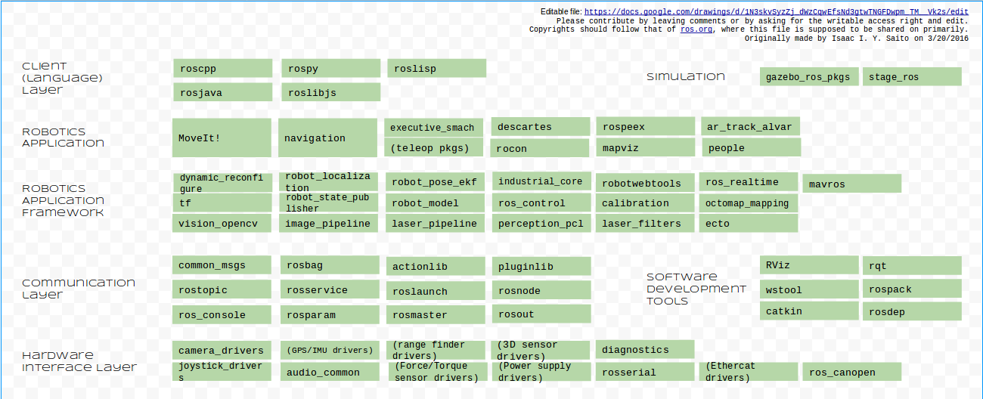
Summary

Slide 25

Thank You !!!

